Slide 1
Lab 4B

Slide 2
What is functional programming? (A farm analogy)
Imagine you have some seeds, but you don’t know what they are
Stream<Seed> seeds = …;

Slide 3
What is functional programming? (A farm analogy)
Plant the seeds and watch them grow
Stream<Plants> plants = seeds.map(plantFn);

Slide 4
What is functional programming? (A farm analogy)
Kill off the weeds
Stream<FruitPlants> fruiters = plants.filter(isNotWeed);

Slide 5
What is functional programming? (A farm analogy)
Now we have a stream of fully grown fruits
But we still don’t know what they are

Slide 6
What is functional programming? (A farm analogy)
Can do
Stream<Stream<Fruit>> fruits = fruiters.map(pickFruitsFn);
But a BETTER way is to
Stream<Fruits> fruits = fruiters.flatMap(pickFruitsFn);
FlatMap combines multiple streams that return the same type

Slide 7
What is functional programming? (A farm analogy)
Now we can do many things
fruits.limit(5).forEach(eat);
Stream<Money> money = fruits.map(sellFruitFn);
Java Streams CANNOT be reused
A stream should be operated on (invoking an intermediate or terminal stream operation) only once. This rules out, for example, "forked" streams, where the same source feeds two or more pipelines, or multiple traversals of the same stream. (https://docs.oracle.com/javase/8/docs/api/java/util/stream/Stream.html)

Slide 8
What is functional programming? (A farm analogy)
What is the point of lab 3 (InfiniteList)?
InfiniteList is like a reusable stream

Slide 9
What is functional programming? (A farm analogy)
FP is taking some source data and applying transformations to all the data.
Includes changing states of objects.
FP makes code more readable and easier to implement logic.
Why use it in Java?
🤷🏻‍♂️

Slide 10
Lab 4A Solution

Slide 11
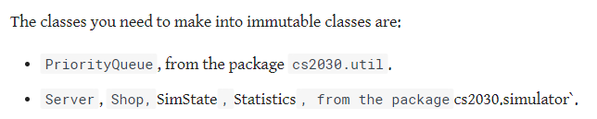

Slide 12
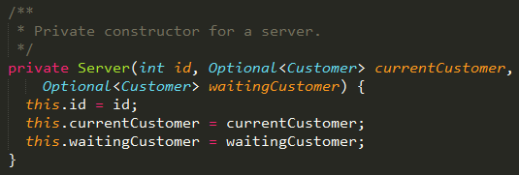
How to make immutable?
Use “dumb” constructors

Slide 13


How to make immutable?
For every method where something changes, create new Server

Slide 14
How to make immutable?
Exactly the same for Statistics class

Slide 15
How to make immutable?
Server belongs to a Shop. So when a Server changes, the Shop also needs to change.
When Shop or Statistics changes, SimState also needs to change.
How to model?

Slide 16
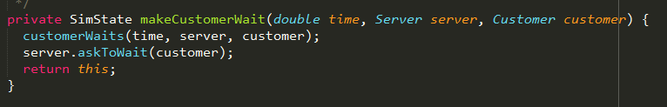
How to make immutable?
Make every change return a new object. Chain methods to get the end result. Example in SimState:

Slide 17


How to make immutable?
Notes:
Will get to log() later

Slide 18


How to make immutable?
New method in SimState to update Shop,
SimState updates Server, passes updated Server to Shop
(also a hint for Lab 4B if you aren’t already doing it this way)

Slide 19
How to make immutable?
When the state of an object is changed, make sure every other containing object changes also.
In this example, Server changed -> Shop Changed -> SimState Changed

Slide 20
How to implement SimState.log?
Recall: Cannot print directly to output (NO SIDE EFFECTS)
Solution: Store output within SimState, either as a very long String or as a LinkedList<String>.

Slide 21

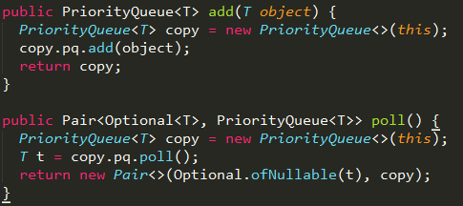
How to make PriorityQueue immutable?
New constructor
Can also use a private addObject(T) method

Slide 22
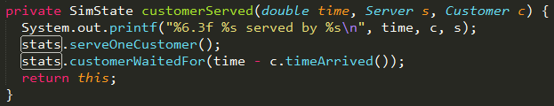

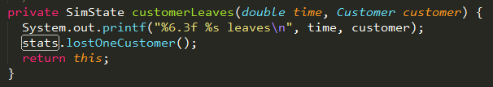

Why are my Statistics NaN 0 0?
NaN is due to division by zero, i.e. your Statistics class has not been touched since the start.
You probably forgot to pass the new Statistics class somewhere

Slide 23
Lab 4B

Slide 24
What do?
Convert ArrivalEvent and DoneEvent to lambda expressions
Convert loops and ifs to streams
Use Optional

Slide 25
How to convert Events to Lambdas?
Change Event to take in a Function
Find places that use new ArrivalEvent or new DoneEvent
Change them to create a new Event, but pass in the logic as a Function

Slide 26
How to convert loops and ifs to streams?
Treat it like you have all the data at once
Apply transformations to them
Example: findIdleServer

Slide 27


How to convert loops and ifs to streams?
.stream() [see Javadocs]
.filter(isIdle)
.findFirst()

Slide 28
How to convert loops and ifs to streams?
Now we’ve generalised both findIdleServer() and findServerWithNoWaitingCustomer()

Slide 29
How to update Servers?
Recall: If one Server changes, need to copy whole list of servers and replace the changed one
- Convert server list to Stream
- Use map() to “find and replace” the server
- Convert Stream back into a list
Collectors will be covered in a later lecture

Slide 30
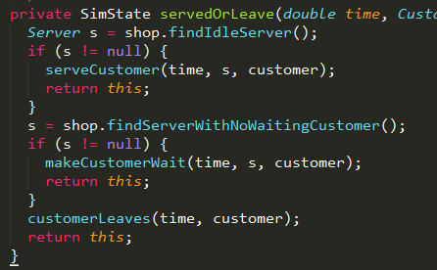
How to do if-else?
Example:

Slide 31
How to use Optionals?
Recall: Optional can be empty, in which case map() does nothing
If Optional is empty, supply a new value
Each “else” = 1 “or”

